Slide 1
Exam Review

Slide 2
Step 1: Organization
Take 5 minutes to organize your handouts & notes
Introduction to History
Culture
Neolithic Revolution
Civilizations
River Valleys
Hammurabi

Slide 3
Step 2: Read directions
Your exam will consist of multiple choice questions and short answer constructed response questions (document questions).
Please use the study guide questions below to help prepare you for the exam. If you complete ALL questions on a SEPARATE sheet (loose leaf, typed, index cards, etc.)
You will receive 5 points towards your exam. All questions must be answered accurately to receive credit. There will be no partial credit given. It is important that you check in with us prior to the exam and completing the review sheet if you do not understand a question below.
Use your handouts and notes to answer the questions. DO NOT USE THE INTERNET. Answers must pertain to what we learned in class.

Slide 4
Step 3: Skim Questions
Read each question…
Put a ? next to questions you are unsure how to answer or where to find the answer
Ask teachers to clear up any misunderstandings before beginning

Slide 5
Step 4: Answer questions & Study
Answer each question THOROUGHLY
STUDY AND READ EACH ANSWER SEVERAL TIMES

Slide 6
How will the test look for Multiple Choice
. . . And with regard to my factual reporting of the events of the war I have made it a principle not to write down the first story that came my way, and not even to be guided by my own general impressions; either I was present myself at the events which I have described or else I heard of them from eye-witnesses whose reports I have checked with as much thoroughness as possible. Not that even so the truth was easy to discover: different eye-witnesses give different accounts of the same events, speaking out of partiality [favor] for one side or the other or else from imperfect memories. And it may well be that my history will seem less easy to read because of the absence in it of a romantic element. It will be enough for me, however, if these words of mine are judged useful by those who want to understand clearly the events which happened in the past and which (human nature being what it is) will, at some time or other and in much the same ways, be repeated in the future. My work is not a piece of writing designed to meet the taste of an immediate public, but was done to last for ever. . . .
—Thucydides: History of the Peloponnesian War
1. In this passage, Thucydides emphasizes his use of what kind of source?
(1) principled
(2) primary
(3) foreign
(4) secondary
2. According to Thucydides, what makes his job as a historian more difficult?
(1) his failing memory
(2) biases of eyewitness observers
(3) lack of romantic elements
(4) his desire to please the immediate public
←Stimulus/Document (quote or photo)
← 1-3 Questions for the quote/photo

Slide 7
How to Answer
. . . And with regard to my factual reporting of the events of the war I have made it a principle not to write down the first story that came my way, and not even to be guided by my own general impressions; either I was present myself at the events which I have described or else I heard of them from eye-witnesses whose reports I have checked with as much thoroughness as possible. Not that even so the truth was easy to discover: different eye-witnesses give different accounts of the same events, speaking out of partiality [favor] for one side or the other or else from imperfect memories. And it may well be that my history will seem less easy to read because of the absence in it of a romantic element. It will be enough for me, however, if these words of mine are judged useful by those who want to understand clearly the events which happened in the past and which (human nature being what it is) will, at some time or other and in much the same ways, be repeated in the future. My work is not a piece of writing designed to meet the taste of an immediate public, but was done to last for ever. . . .
—Thucydides: History of the Peloponnesian War
1. In this passage, Thucydides emphasizes his use of what kind of source?
(1) principled
(2) primary
(3) foreign
(4) secondary
2. According to Thucydides, what makes his job as a historian more difficult?
(1) his failing memory
(2) biases of eyewitness observers
(3) lack of romantic elements
(4) his desire to please the immediate public
←Actively read/Annotate the document
←Annotate & Eliminate answers

Slide 8
How to Answer
. . . And with regard to my factual reporting of the events of the war I have made it a principle not to write down the first story that came my way, and not even to be guided by my own general impressions; either I was present myself at the events which I have described or else I heard of them from eye-witnesses whose reports I have checked with as much thoroughness as possible. Not that even so the truth was easy to discover: different eye-witnesses give different accounts of the same events, speaking out of partiality [favor] for one side or the other or else from imperfect memories. And it may well be that my history will seem less easy to read because of the absence in it of a romantic element. It will be enough for me, however, if these words of mine are judged useful by those who want to understand clearly the events which happened in the past and which (human nature being what it is) will, at some time or other and in much the same ways, be repeated in the future. My work is not a piece of writing designed to meet the taste of an immediate public, but was done to last for ever. . . .
—Thucydides: History of the Peloponnesian War
1. In this passage, Thucydides emphasizes his use of what kind of source?
(1) principled truth
(2) primary someone who was at the event/witness
(3) foreign unfamiliar
(4) secondary someone who was not at the event
2. According to Thucydides, what makes his job as a historian more difficult?
(1) his failing memory
(2) biases of eyewitness observers bias—one sided, favoritism
(3) lack of romantic elements
(4) his desire to please the immediate public
←Actively read/Annotate the document
←Annotate & Eliminate answers

Slide 9
How to Answer
. . . And with regard to my factual reporting of the events of the war I have made it a principle not to write down the first story that came my way, and not even to be guided by my own general impressions; either I was present myself at the events which I have described or else I heard of them from eye-witnesses whose reports I have checked with as much thoroughness as possible. Not that even so the truth was easy to discover: different eye-witnesses give different accounts of the same events, speaking out of partiality [favor] for one side or the other or else from imperfect memories. And it may well be that my history will seem less easy to read because of the absence in it of a romantic element. It will be enough for me, however, if these words of mine are judged useful by those who want to understand clearly the events which happened in the past and which (human nature being what it is) will, at some time or other and in much the same ways, be repeated in the future. My work is not a piece of writing designed to meet the taste of an immediate public, but was done to last for ever. . . .
—Thucydides: History of the Peloponnesian War
1. In this passage, Thucydides emphasizes his use of what kind of source?
(1) principled truth
(2) primary someone who was at the event/witness
(3) foreign unfamiliar
(4) secondary someone who was not at the event
2. According to Thucydides, what makes his job as a historian more difficult?
(1) his failing memory
(2) biases of eyewitness observers bias—one sided, favoritism
(3) lack of romantic elements
(4) his desire to please the immediate public
←Actively read/Annotate the document
←Annotate & Eliminate answers

Slide 10
How will the test look for Stimulus Questions
Question 1 – one document in a form of a quote or picture asking about context
Historical circumstance OR Geographic context
Question 2 – a second document in a form of a quote or picture
Bias, point of view, audience OR purpose
Question 2- both document 1 and 2 used together
Answer MUST USE EVIDENCE FROM BOTH DOCUMENTS
Cause and effect, comparison (similarity or difference) OR turning point
IDENTIFY
EXPLAIN

Slide 11
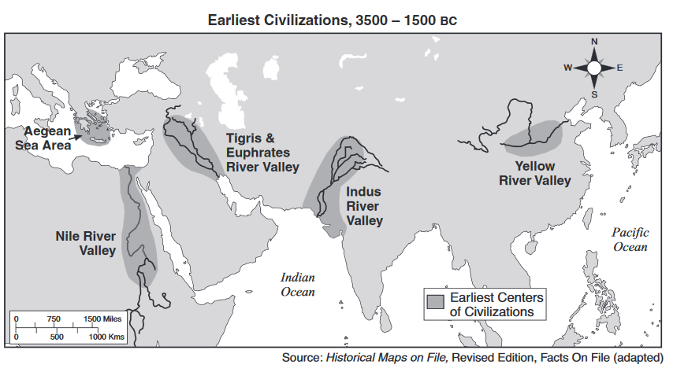
Document 1:
Geographic context: where this historical development is taking place, and why it is taking place there.
1. Using document 1, explain how the geographic context for the historical development shown on this map.

Slide 12
DOCUMENT 2: Source: William Howells, Back of History, Doubleay & Co. writing about the “Neolithic Age.”
Then, about 6000 B.C., and somewhere in the Near East (as far as we know), the Neolithic way of life began. It is still called “Neolithic” (New Stone Age, as Mesolithic means Middle, and Paleolithic means Old Stone Age), because the older anthropologists saw everything in the light of stonework, and thought of this “period” as the age of polished stone axes. But it means, rather, a state of culture in which food is planted and bred, not hunted and gathered — in which food is domesticated, not wild. If we had to choose the greatest single change in human history right up to the present, this would be it. I mean, of course, a change by cultural evolution, as distinct from a biological change like standing erect, or gradually becoming able to use culture and language in the first place. And I do not mean that the change was sudden, or dramatic to those who were changing, as though a light were being switched on. It was dramatic, but long after, in its consequences, because everything else we have achieved flowed out of this as a beginning. . .
2. Using document 2, identify William Howell’s point of view of the Neolithic Revolution

Slide 13
Use both Documents 1 and 2 to answer the questions below.
Then, about 6000 B.C., and somewhere in the Near East (as far as we know), the Neolithic way of life began. It is still called “Neolithic” (New Stone Age, as Mesolithic means Middle, and Paleolithic means Old Stone Age), because the older anthropologists saw everything in the light of stonework, and thought of this “period” as the age of polished stone axes. But it means, rather, a state of culture in which food is planted and bred, not hunted and gathered — in which food is domesticated, not wild. If we had to choose the greatest single change in human history right up to the present, this would be it. I mean, of course, a change by cultural evolution, as distinct from a biological change like standing erect, or gradually becoming able to use culture and language in the first place. And I do not mean that the change was sudden, or dramatic to those who were changing, as though a light were being switched on. It was dramatic, but long after, in its consequences, because everything else we have achieved flowed out of this as a beginning. . .
Turning point: a major event, idea, or historical development that brings about significant change. It can be local, regional, national, or global.
3a. Identify a turning point associated with the historical developments related to both documents 1 and 2.
3b. Explain why the historical developments and events associated with these documents are considered a turning point. Be sure to use evidence from both documents 1 & 2 in your response.

Slide 14
Self Reflection
This review was
Helpful
Somewhat helpful
Confusing
Questions I still have are…

