Slide 1
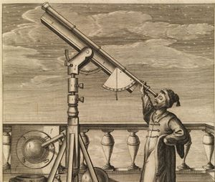
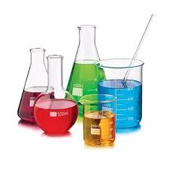
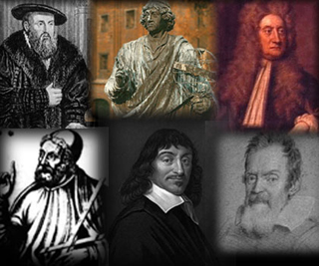
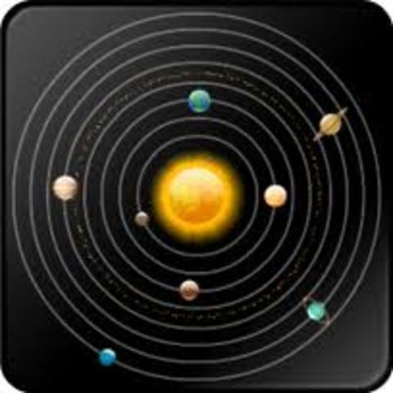
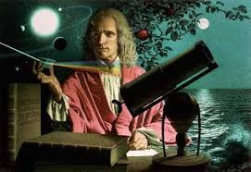
The Scientific Revolution

Slide 2
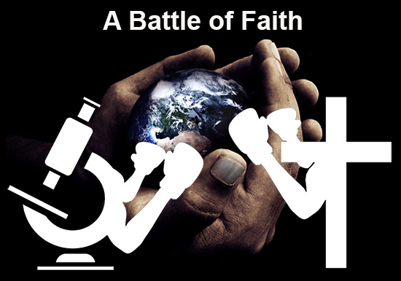
What was the Scientific Revolution?
The Scientific Revolution was a time of intense debate between science and religion.
Helped to develop:
  Modern scientific practices
  New scientific thought

Slide 3
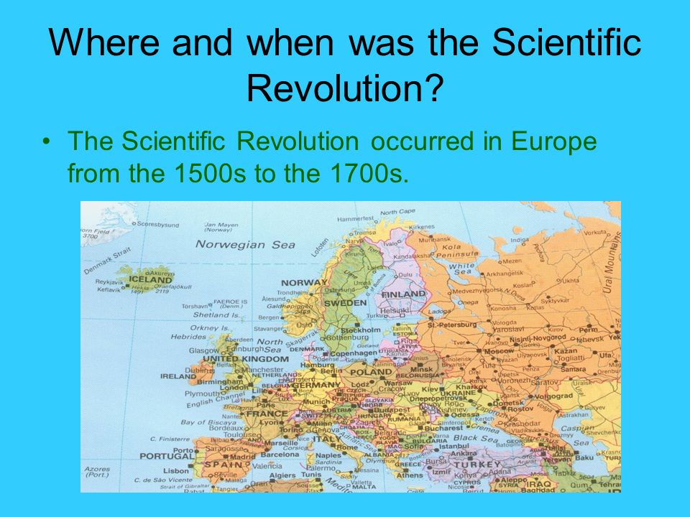

Slide 4
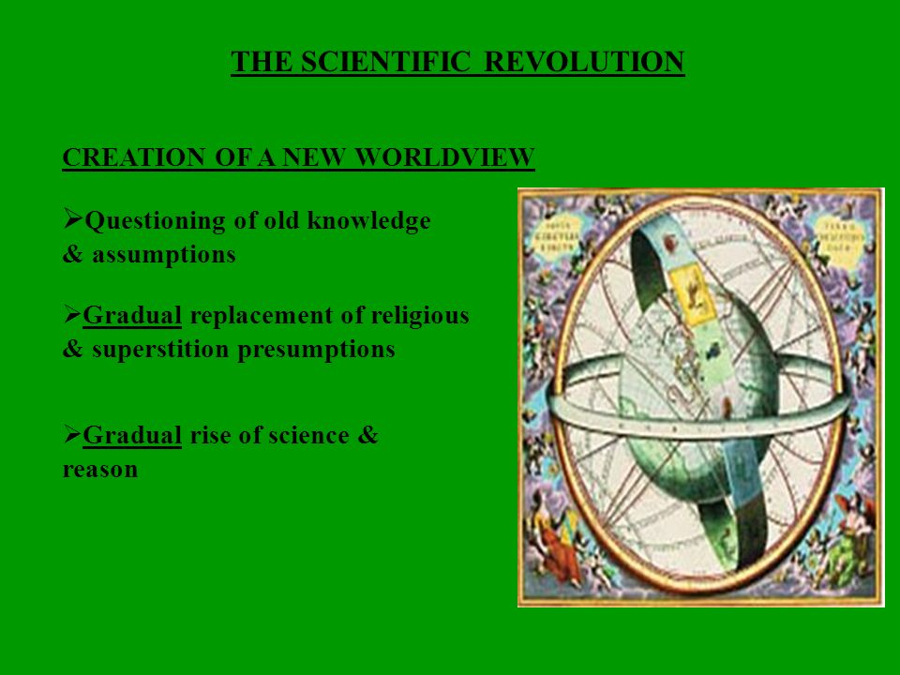

Slide 5
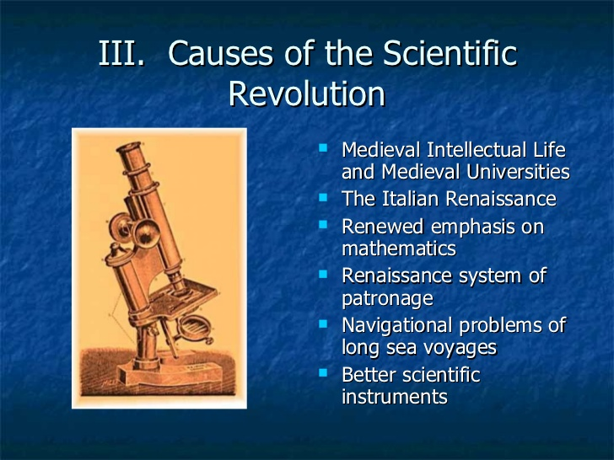

Slide 6
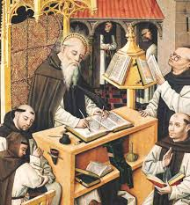
What was Europe life like prior to the Scientific Revolution?
Prior to the Scientific Revolution many Europeans were ignorant of basic earth science
  Little education
  Little Knowledge
Knowledge that did exist was controlled by the R.C.C.

Slide 7
Most scientific teachings in the Church were based on Biblical theory & ancient Greek science.
Examples:
  The earth is the center of the universe (geocentric theory)
  Four major elements
  God controls motion / laws of movement (gravity)

Slide 8
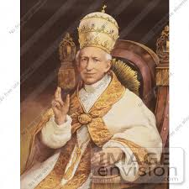
The Power of the Catholic Church
The Catholic Church served as the authority for politics and society.
The R.C.C. viewed the Bible as the sole source of information.
The R.C.C. viewed the new scientific research as a threat to their power.

Slide 9

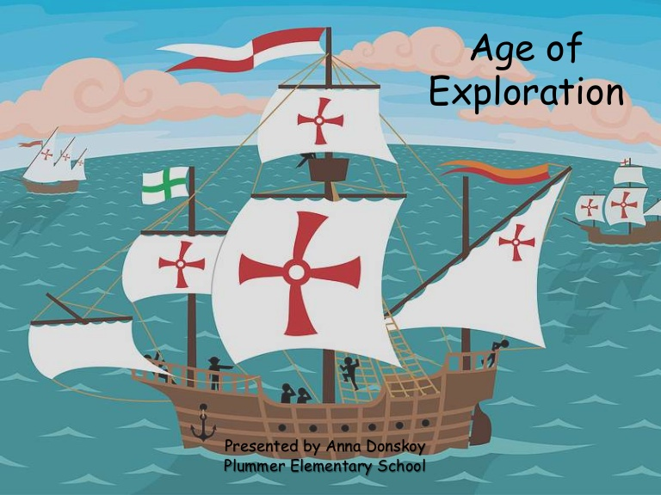
The Scientific Revolution begins
Europeans were influenced by Muslims and Renaissance scholars
  Began to question Church authority
European discoveries outside of Europe also fueled scientific questions.

Slide 10
Muslim Scholars

Slide 11
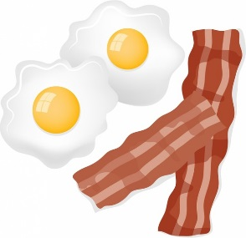
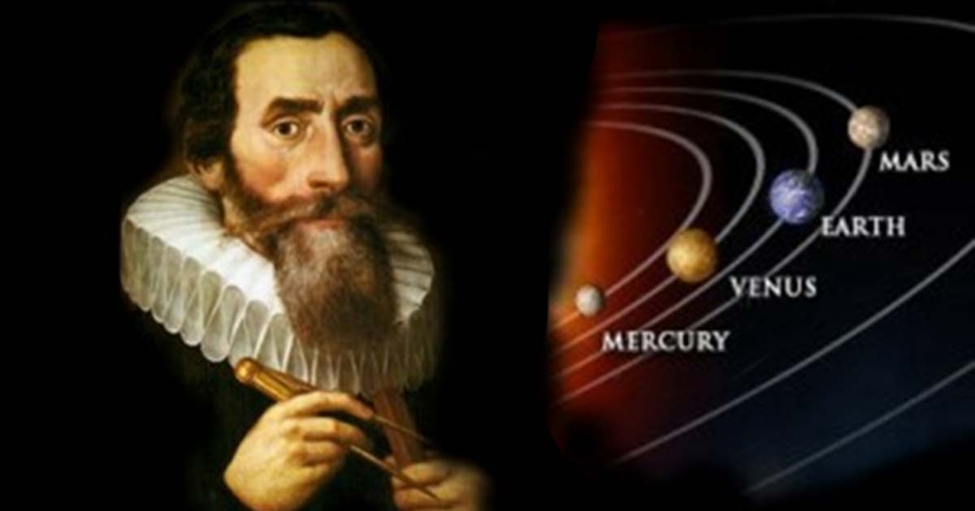

Major Figures of the Scientific Revolution
Galileo Invented the telescope
Sir Isaac Newton
  Laws of Motion / Gravity
Sir Francis Bacon
  Scientific Method
Johannas Keplaer
  Laws of planetary motion

Slide 12
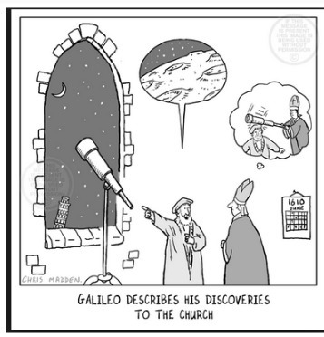
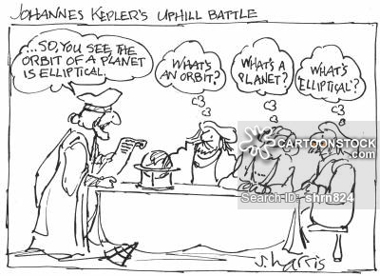
Historical Perspectives on the Challenges that Scientific Revolutionary Scientist Faced.

Slide 13
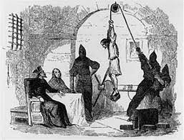
How did the Church respond to these scientific challenges?
The Church responded with fear to these new challenges.
Scientist who criticized the Church were brought before the Inquisition (Church court )
  Charged with heresy
  Tortured /executed/ house arrest
  excommunicated

Slide 14
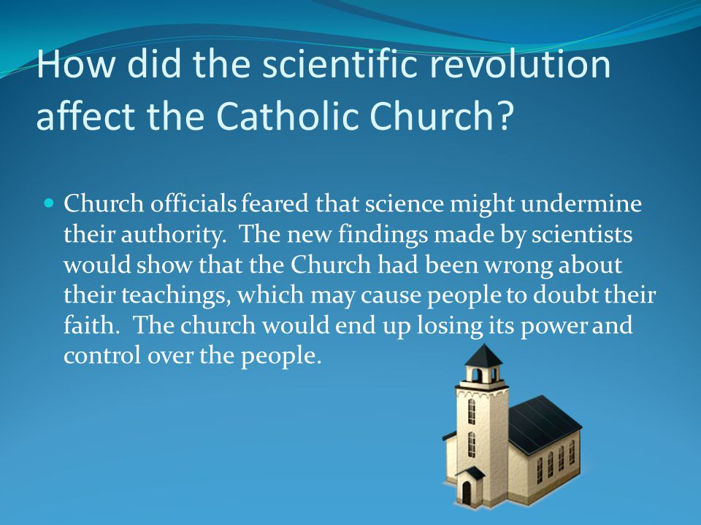

Slide 15
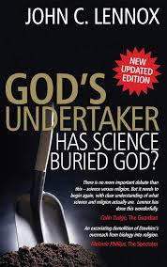
Impact of Scientific Revolution on Europe
The Scientific Revolution had to enduring (lasting) effects:
Changed the way people view science from negatively to positively
Continued to weaken the power of the church.

Slide 16
Creationism v. Evolution
Adam & Eve
Theory of Evolution

Slide 17
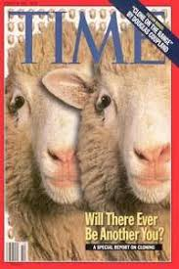

Cloning

Slide 18
Stem Cell Research

Slide 19
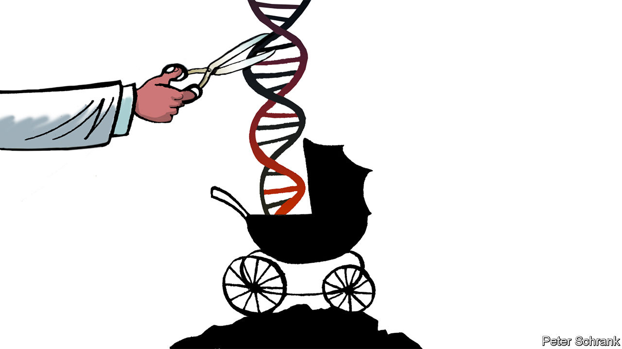
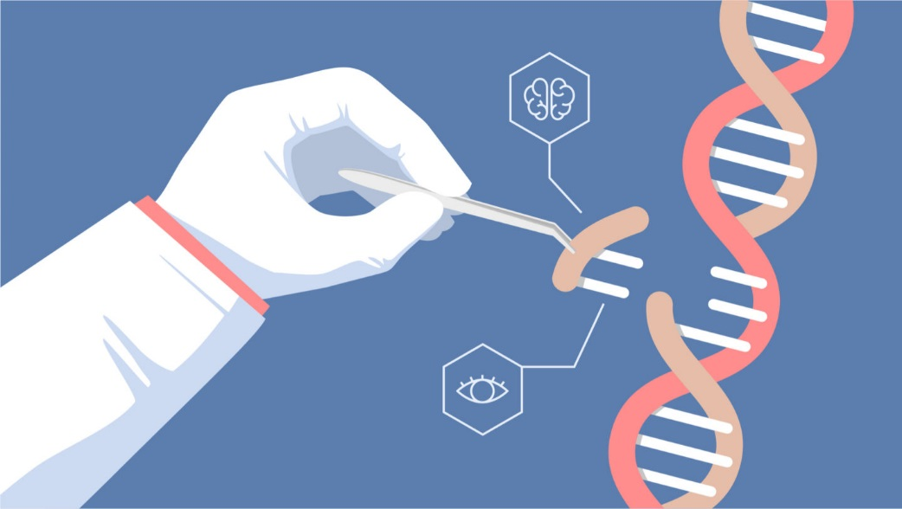
Gene Editing

Slide 20
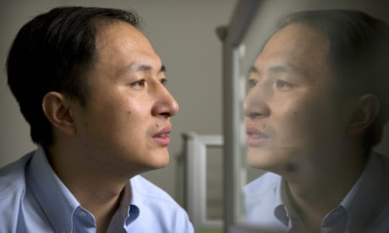
Gene Editing
The Chinese scientist, He Jiankui claims to have altered (changed) the DNA of twin girls before birth – without going through the usual scientific channels – said he was proud of his work.
The Nobel laureate David Baltimore, who is professor emeritus of biology at the California Institute of Technology, called He’s work irresponsible.
“It is impossible to overstate how irresponsible, unethical and dangerous this is at the moment,” said Kathy Niakan, a scientist at the Francis Crick
Matthew Porteus, professor of pediatrics at Stanford University, said: “He’s already at risk of becoming a pariah (outcast) ”
In the UK and many other countries it is illegal to create genetically modified babies, and scientists in the field have reached a broad consensus (agreement) that it would be deeply unethical (wrong) to try. Genome editing is not considered safe, and any genetic modifications – whether beneficial or unintentionally harmful – affect not only the child, but their children and future generations.

